Slide 1

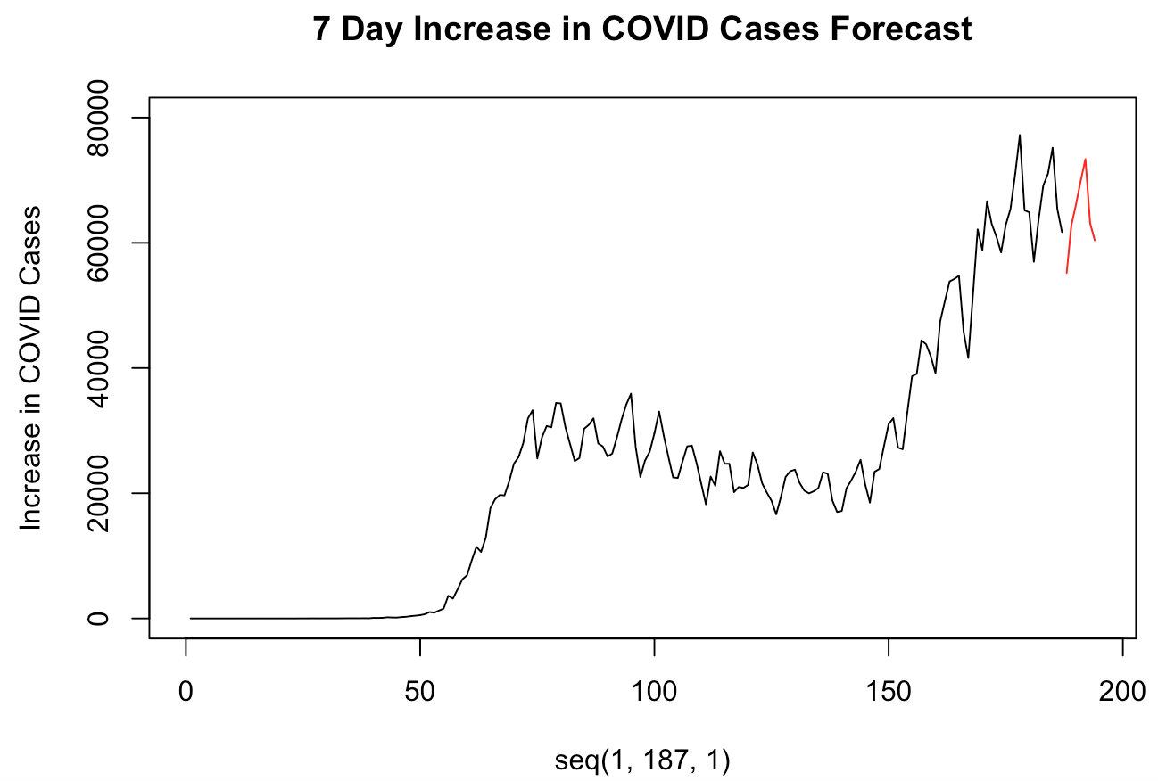
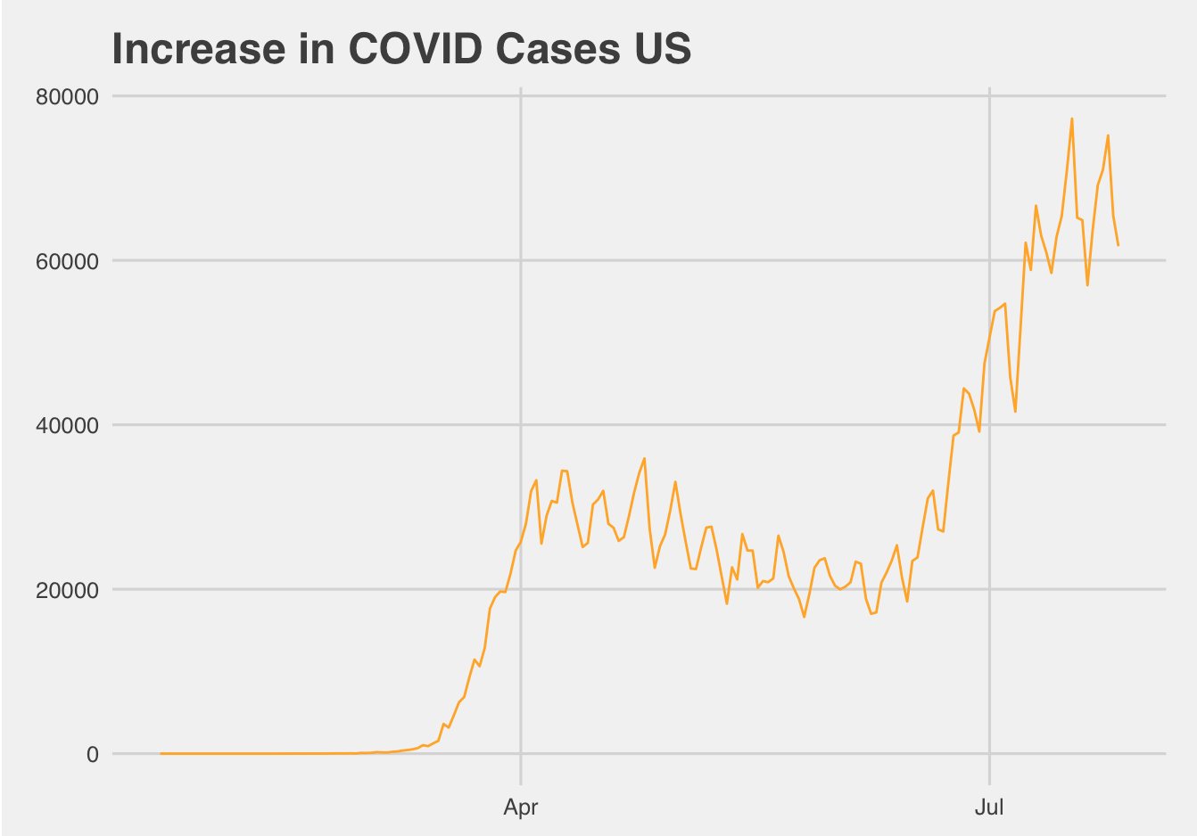
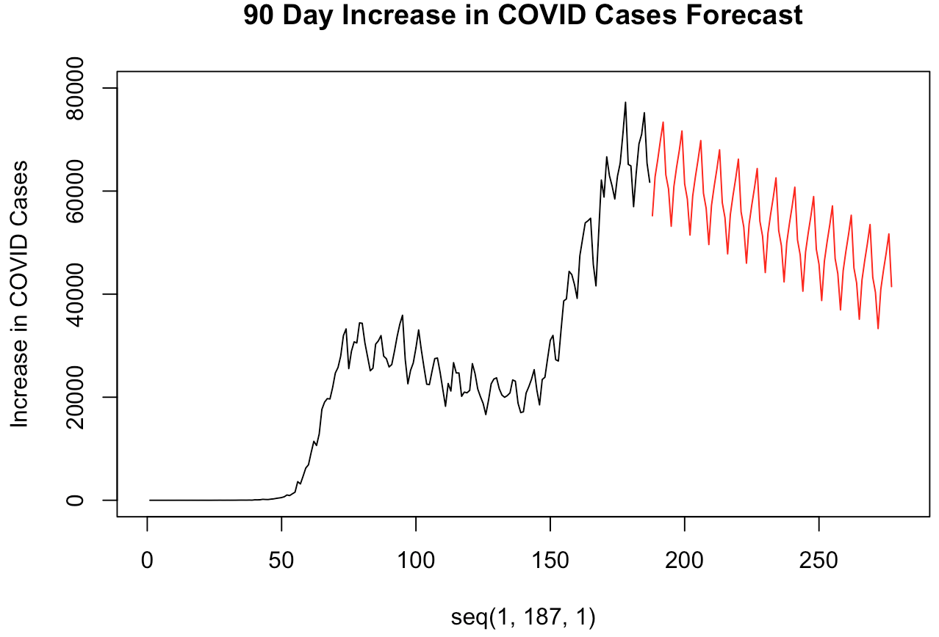

United States
Regressor variable analysis
MLR
MLP
Notes:
Jaclyn
Time: 21 seconds
We evaluated the US variables available to help predict hospitalization cases, we surfaced that many of the metrics that are being collected are ones that would actually occur after hospitalization. Such as, ICU admittance, ventilator use, and death. None of these metrics make sense to use as regressors in our modeling process. So we decided to leverage new COVID cases only as our regressor for predicting hospitalized COVID cases.

